Slide 1

“About myself” ICA assignment
Aliyan Javaid-24641

Slide 2
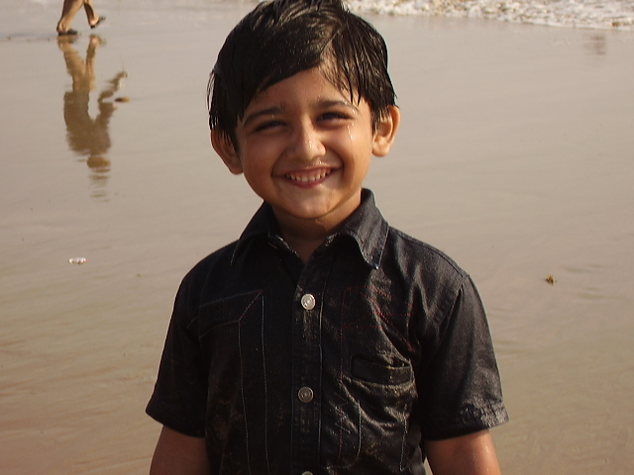
Name: Aliyan Javaid Age: 19 years and 3 months
Date of birth:
06-09-2002

Slide 3
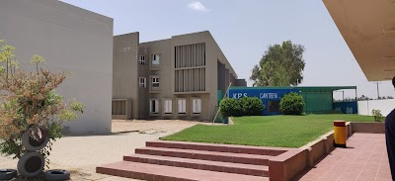
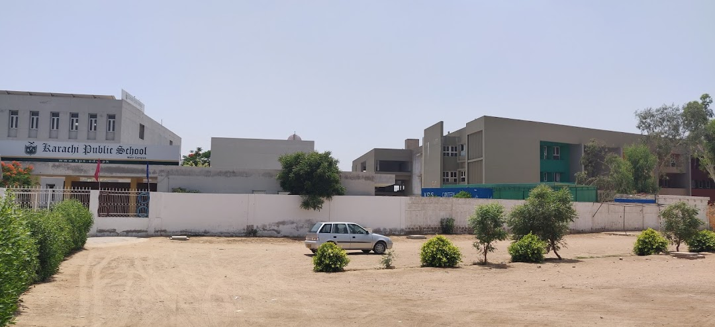
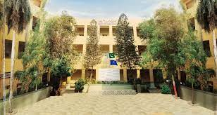
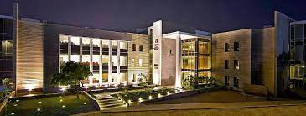
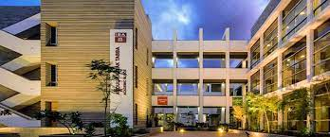
Education:
1.)Nursery to matric from Karachi public School.
2.) Intermediate college (first year and second year) from
Adamjee Government science college.
3.) currently studying in
Institute Of Business Administration.

Slide 4
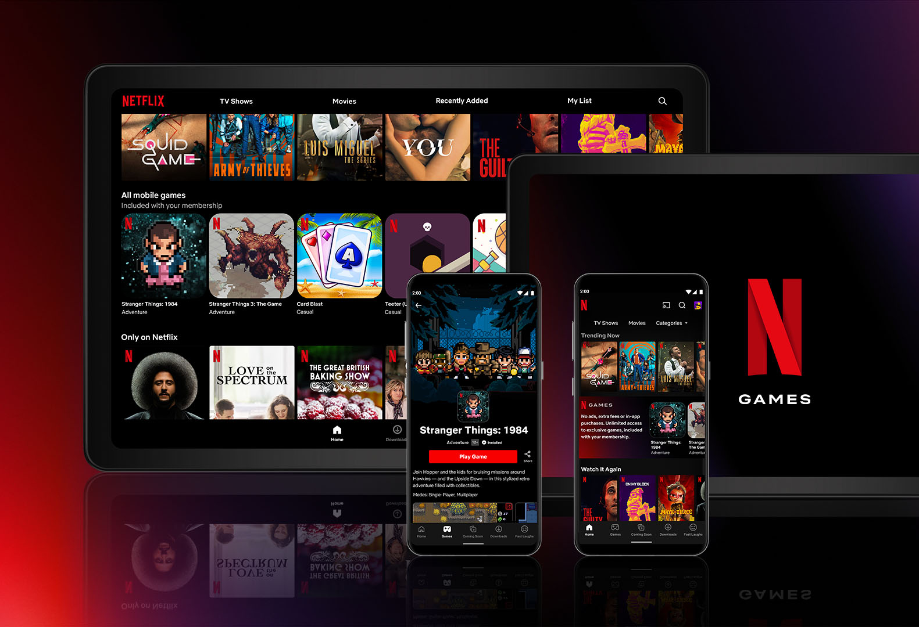

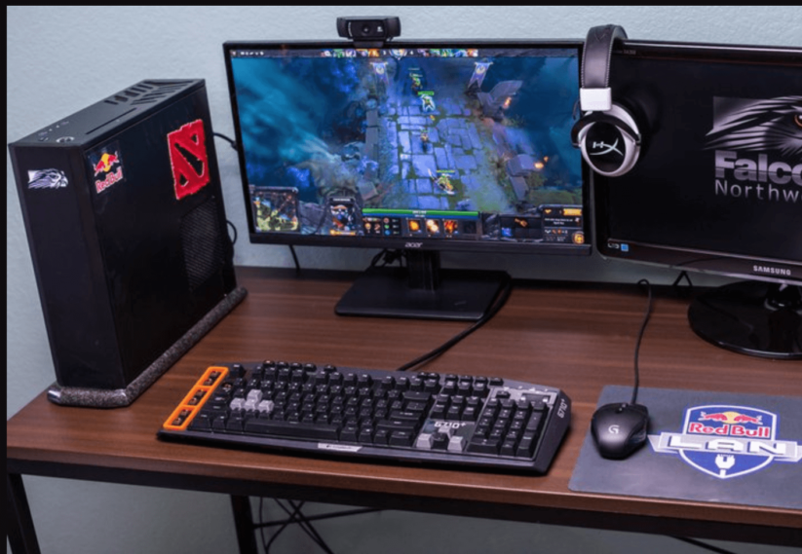
Hobbies And Passion
Watching series and movies
Gaming
Playing Guitar and singing

Slide 5
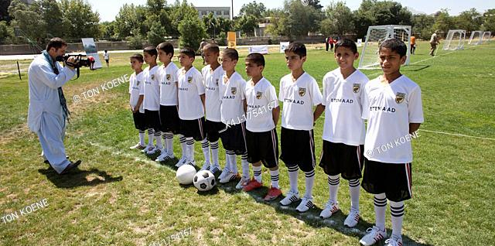

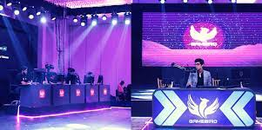
Achievements
Awarded as MVP(most valuable player) in computer games
like Counter Strike GO and Dota2
Won and served as captain of the football team in interbranch football
Competition, hosted by Karachi public School (Sports Gala)
Won second price in Inter-branch science essay writing competition

Slide 6

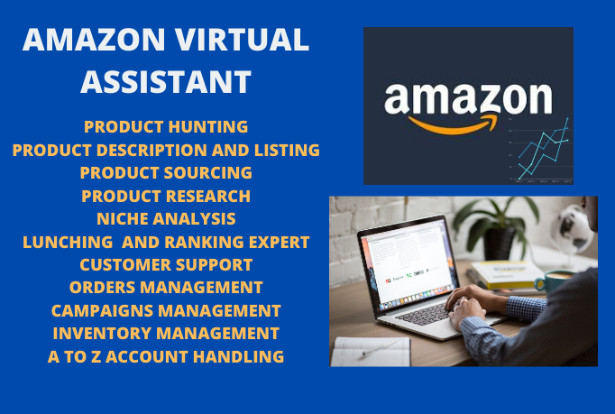
Work Experiences
Served as a Proxy marketer(PM)
in Amazon.
Currently Working as a Virtual Assistant(VA) in Amazon.

Slide 7
Goals to Accomplish
Learning different skills to make myself enough worthy to adjust in the environment.
Start Journaling increasing vocabulary and writing skills.
Fulfil my parent expectation and work hard to give them something in return.
Staying organized.
Working out and staying healthy
Apart from studies, indulging myself in side projects.

Slide 8
Family
Four Person Family.
Mom, Dad one elder sister and me myself.

Slide 9
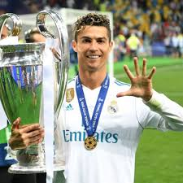
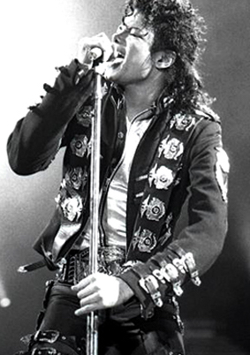
Favorite celebrity and sports player.
My favorite singer is Michael Jackson (King Of Pop),not only because of his music but also because of his dance and fashion style.
One of my favorite player is from football sports, Cristiano Ronaldo who won 32 trophies up till now including seven leagues title.

Slide 10
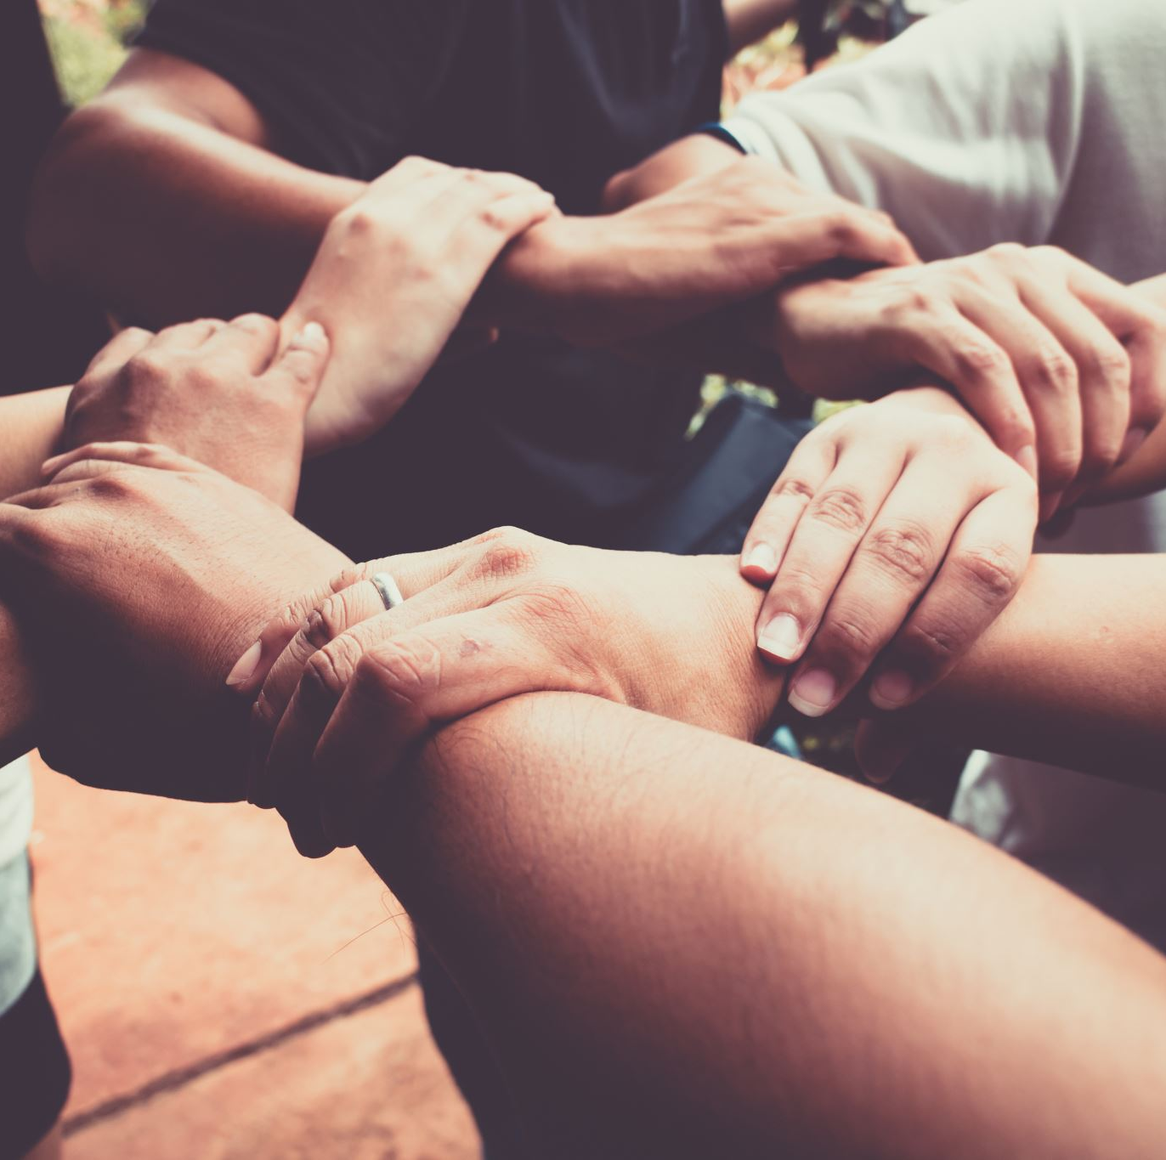
Friendship for me
In my belief, friendship assist youth with a feel, a sense of feeing of acknowledgment and having a place. In addition, adolescent association with peer supports the improvement of sympathy , mindful and compassion. I have a lot of friends but somehow due to the speed of time, we as a whole lost contacts. But after coming to IBA, in my discernment, it will be hard to make new friends in such new atmosphere , yet I was off based , IBA has blessed me with a gathering of friends with the flawless heart who are always there for me in each period of life, and we all tires to make enough memories so that once we recall it after we graduate. It will give us a sense of harmony and pleasure.

Slide 11
My belief to have a prosperous life
To have a bunch of friends because friendship truly matters
Not to stress and work with mind in troublesome time
Value time
Exercise daily and have enough sleep to stay healthy
Have objectives every year which you need to achieve before its finishes.

Slide 12
Experties
I’m expert in MS word, MS excel, Keyboarding through guidance of sir, Waseem Arain.
I’m master in speaking with various individuals on account of Proxy marketing, as in that I need to communicate with everybody around the World.
I’m expert as a freelancer.

Slide 13
My Advice
I follow these quotes and I will recommend everyone to follow it to stay motivated and to gain success.
“Your positive action combined with positive thinking results in success”.
“ Action is the foundational key to success”.

